Slide 1
Microprocessors and Assembly Language Lecture 12 Hamed Farbeh farbeh@aut.ac.ir Spring 2023

Slide 2
Copyright Notice
Parts (text & figures) of this lecture are adopted from:
https://www.analogictips.com/pulse-width-modulation-pwm/
Atmel | SMART ARM-based MCU DATASHEET, SAM3X / SAM3A Series, Atmel-11057C-ATARM-SAM3X-SAM3A-Datasheet_23-Mar-15

Slide 3
Pulse Width Modulation (PWM)

Slide 4
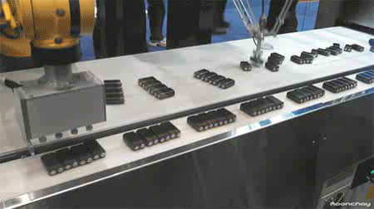




Pulse Width Modulation (PWM)

Slide 5
PWM: What is it and how does it work?
Digital signals have two positions
on or off, interpreted in shorthand as 1 or 0
Analog signals can be
on, off, half-way, two-thirds the way to on, and an infinite number of positions between 0 and 1
To take an analog input signal (e.g., temperature) into a microcontroller
by using an analog-to-digital converter
But what about outputs?
PWM is a way to control analog devices with a digital output
Drive analog devices like variable-speed motors, dimmable lights, actuators, and speakers

Slide 6
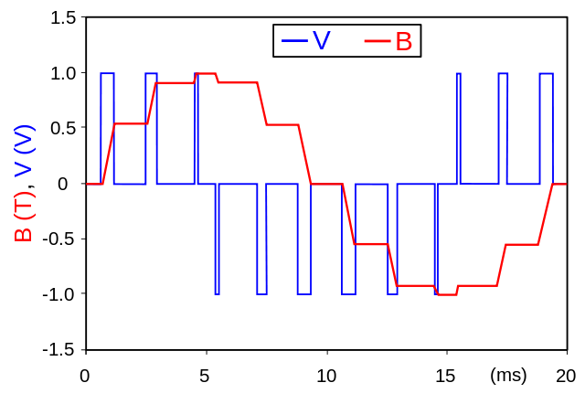
PWM: What is it and how does it work?
PWM is not true analog output
PWM “fakes” an analog-like result by applying power in pulses, or short bursts of regulated voltage
Is a fancy term for describing a type of digital signal
The pulse width and corresponding duty cycle change so that the average voltage looks more like an analog output that is not in a steady-state

Slide 7
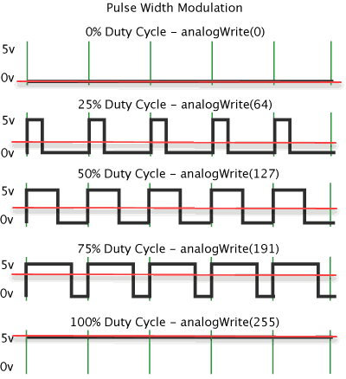
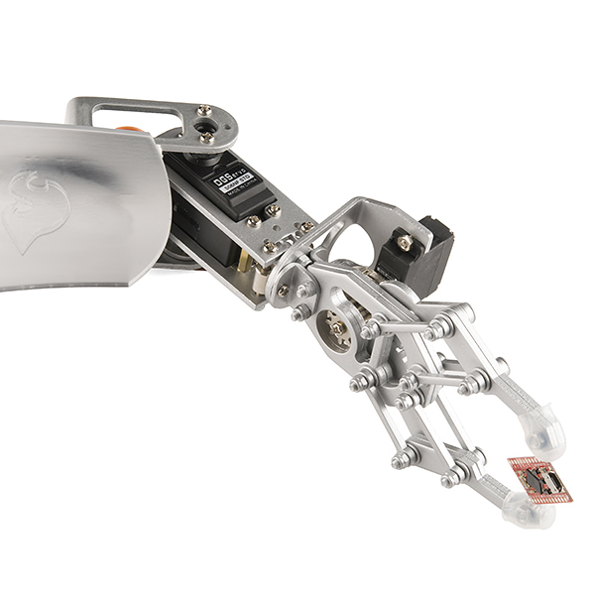

PWM: What is it and how does it work?
A device that is driven by PWM ends up behaving like the average of the pulses
The average voltage level can be a steady voltage or a moving target (dynamic/changing over time)
Average Voltage =
Duty Cycle $×$ High Voltage Level

Slide 8


PWM: An Example
Controlling the brightness of an LED by adjusting the duty cycle
With an RGB (red green blue) LED,
you can control how much of each of the three colors you want in the mix of color by dimming them with various amounts

Slide 9
PWM in SAM3X: Description
The PWM macro cell controls 8 channels independently
Each channel controls two complementary square output waveforms
Embedded Characteristics
Common Clock Generator Providing Thirteen Different Clocks
A Modulo n Counter Providing Eleven Clocks
Two Independent Linear Dividers Working on Modulo n Counter Outputs
Independent Clock Selection for Each Channel
Independent Period, Duty-Cycle and Dead-Time for Each Channel

Slide 10
PWM in SAM3X: PWM Power Management
The PWM is not continuously clocked.
Before using the PWM macro cell, the programmer must first enable the PWM clock in the Power Management Controller (PMC)
If the application does not require PWM operations, the PWM clock can be stopped when not needed and be restarted later.
In this case, the PWM will resume its operations where it left off.

Slide 11
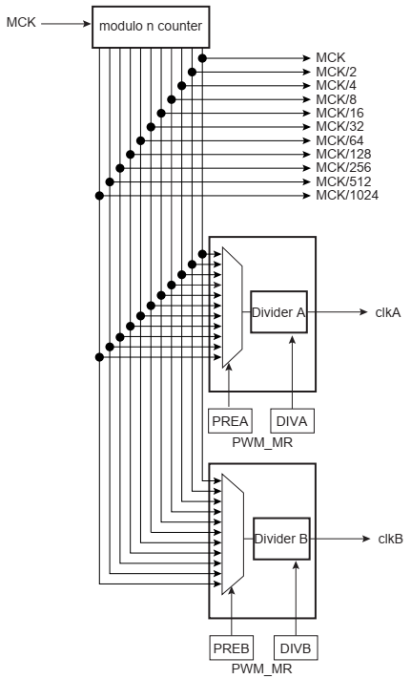
PWM in SAM3X
PWM Clock Generator

Slide 12
PWM in SAM3X: PWM Clock Generator
Master Clock (MCK) is the clock of the peripheral bus to which the PWM is connected.
The PWM master clock (MCK) is divided in the clock generator module to provide different clocks available for all channels. Each channel can independently select one of the divided clocks.
The clock generator is divided in three blocks:
a modulo n counter which provides 11 clocks: FMCK, FMCK/2, FMCK/4, FMCK/8, FMCK/16, FMCK/32, FMCK/64, FMCK/128, FMCK/256, FMCK/512, FMCK/1024
two linear dividers (1, 1/2, 1/3, ... 1/255) that provide two separate clocks: clkA and clkB

Slide 13
PWM in SAM3X: PWM Clock Generator
Each linear divider can independently divide one of the clocks of the modulo n counter. The selection of the clock to be divided is made according to the PREA (PREB) field of the PWM Clock register (PWM_CLK). The resulting clock clkA (clkB) is the clock selected divided by DIVA (DIVB) field value.

Slide 14
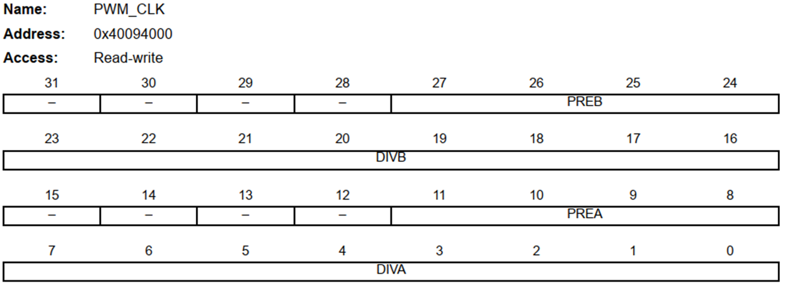
PWM in SAM3X: PWM Clock Generator
PWM Clock Register can only be written if the bits WPSWS0 and WPHWS0 are cleared in “PWM Write Protect Status Register”

Slide 15
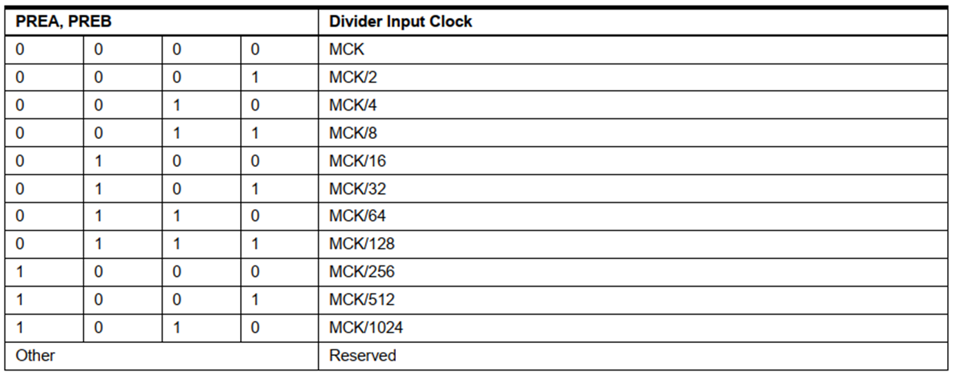
PWM in SAM3X: PWM Clock Register

Slide 16
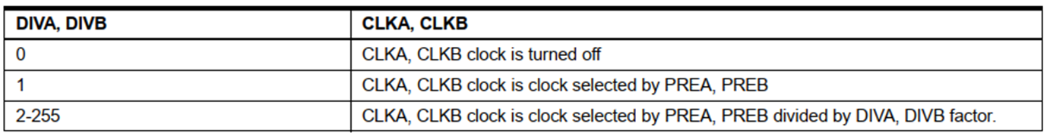
PWM in SAM3X: PWM Clock Register

Slide 17
The End!

